Slide 1

Automatic Recognition
of Student Engagement
Using deep learning and facial expression
Omid Mohamad Nezami, Mark Dras, Len Hamey, Deborah Richards, Stephen Wan, and C´ecile Paris
Published in ECML PKDD 2019
Paper Link : https://ecmlpkdd2019.org/downloads/paper/241.pdf
Presenter:
Srijit Sen
(CS21MDS14009)
Teaching Assistant :
Khin Cho Win
Research Scholar
Instructor:
Dr. C Krishna Mohan
Professor

Slide 2
Summary from Previous Presentation

Slide 3
Motivation

Slide 4


Current problems
Even with the progress made in deep learning and faster processing speed, most engagements are still measured through manual processes like surveys, form fill ups and one-on-one interactions
Resulting in wastage of time during manual efforts
Data inconsistencies while taking feedback due to human error
Incomplete data, as not all are willing to provide information or even the correct information

Slide 5
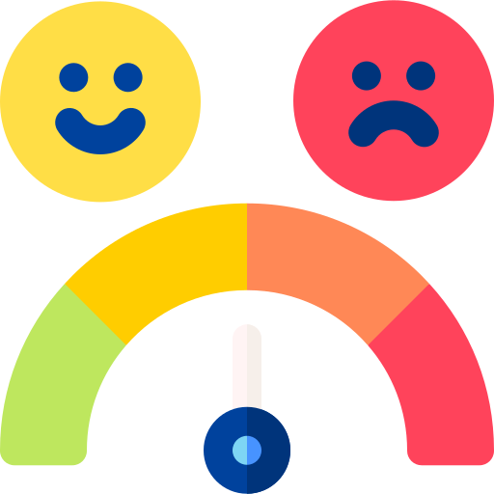
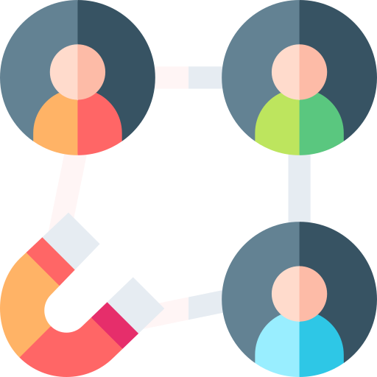
Why Automate Engagement?
Images provide accurate information on the state of their mind during the engagement period
With a good model, level of satisfaction can be measured more accurately
Real time actions can be taken based on the emotion at the time to keep the students engaged

Slide 6
Problem Statement

Slide 7

What does this paper try to do?
Quantify and characterize engagement during learning via technology by automatically measuring it using facial expressions extracted from images
Challenge is to design a rich engagement representation model to distinguish engaged and disengaged samples, which requires a large amount of data that is difficult and expensive to collect and annotate due to the complexities and ambiguities of the engagement concept.
Use of a rich face representation model to capture basic facial expressions and initialize an engagement recognition model, the collection of a new dataset called the Engagement Recognition (ER) dataset to facilitate research on engagement recognition from images, and the use of deep learning techniques to model engagement, which outperforms a comprehensive range of baseline approaches on the ER dataset

Slide 8
Existing Work & Limitations

Slide 9
Other Related Work
Deep learning models have shown success in automatically recognizing facial expressions, with convolutional neural networks (CNNs) being a popular choice. Studies have used frameworks of six universal emotions: sadness, happiness, fear, anger, surprise, and disgust, along with a neutral category.
Other studies have combined visual and audio features, applied face detection methods, and trained CNN models across different FER datasets to enhance generalizability
Engagement has been detected in three different time scales: entire learning sessions, 10-second video clips and images. Grafsgarrd classified using linear regression while linear SVMs with Gabor features were used by Whitehall, heart rate features by [Monkaresi et al.], and Bayesian classifiers by [Bosch et al]. However, accurately assigning a single engagement label to each clip has been difficult and inaccurate
HOG+SVM model is similar to that of [Kamath et al] for recognizing engagement from images and is used as a baseline model in this work and applies gradient directions or edge orientations to express objects in local regions of images
Notes:
whitehill et al. [35] showed that engagement patterns are mostly recorded in images. Bosch et al. [4] also confirmed that video clips could not provide extra information by reporting similar performances using different lengths of video clips in detecting engagement

Slide 10
Limitations
Recognition of subtle differences:
Facial expressions can be very subtle, hence can pose a challenge to detect and differentiate between similar expressions, such as a smile and a smirk where the difference is very subtle
Limitations on available data:
Training a deep learning model for facial expression recognition requires a vast amount of data, which may not be easily accessible, particularly for rare expressions or populations.
Real-time recognition cases :
In some applications, such as human-robot interaction or driver monitoring, facial expressions need to be recognized in real-time due to the nature of the situation, which definitely is challenging due to the computational complexity of deep learning models

Slide 11
Limitations (contd.)
Subjectivity of engagement:
Engagement is a complex construct that can be challenging to define and measure objectively. Different individuals may have different engagement levels, and engagement can vary over time and across contexts
Availability of labeled data:
The availability of labeled data for engagement recognition is limited, particularly for fine-grained engagement levels or for specific populations. This can limit the development and evaluation of deep learning models for engagement recognition.
Integration of multiple modalities:
Engagement is not just conveyed through facial expressions but also through other nonverbal cues, physiological signals, and self-reported data. Integrating these modalities can improve the accuracy of engagement recognition but can also add complexity to the model.

Slide 12
Methodology in Detail
Setup
Facial Representation model and Architecture
Baseline Models and ER Model Architecture

Slide 13
Setup
Image data collected from students and annotated with behavior and engagement labels
FER 2013 Data
Input data
Input data
CNN Model
Generalized Facial Representation Model
The Class probabilities are used to initialize the softmax layer of ER model
ER Model
VGGNet Model
Engaged vs disengaged prediction
Input data
HOG+ SVM model
Performance evaluation by comparison with other baseline models
Notes:
new dataset annotated by Psychology students, who can potentially better recognize the psychological phenomena of engagement, because of the complexity of analyzing student engagement. To assist them with recognition, brief training was provided prior to commencing the task and delivered in a consistent manner via online examples and descriptions

Slide 14
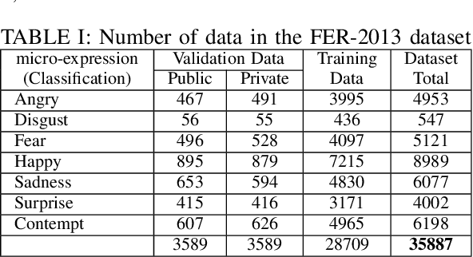
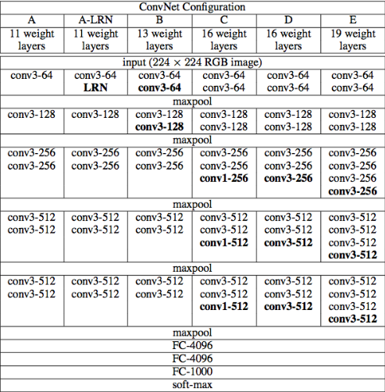
Facial Representation Model Architecture
Trained a VGG-B model using this dataset to recognize facial expressions, training set into two parts after removing 11 completely black samples, 3,589 for validating and 25,109 for training our facial expression recognition model
Used the Facial Expression Recognition 2013 (FER-2013) dataset, which contains grayscale images labeled with seven different emotions
Notes:
Adapted from VGG-B framework [32]. Each rectangle is a Conv. block including two Conv. layers. eight Conv. and three fully connected layers. We also have a max pooling layer after each Conv. block with stride 2. The model’s output layer has a softmax function generating the categorical distribution probabilities over seven facial expression classes

Slide 15
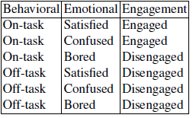

Engagement Recognition Model
ER dataset
consisting of 4,627 annotated images including 2,290 engaged and 2,337 disengaged
3,224 training dp
715 validation dp
688 test dp
Collected and annotated data with the psychologists, each sample is categorized
as engaged or disengaged by combining the dimensions’ For example, if a particular annotator labels an image as on-task and satisfied, the category for this image from this annotator is engaged
Notes:
normalized so that it has a zero mean and a norm equal to 100:0. Furthermore, for each pixel location, the pixel values are normalized to mean zero and standard deviation one using all ER training data

Slide 16
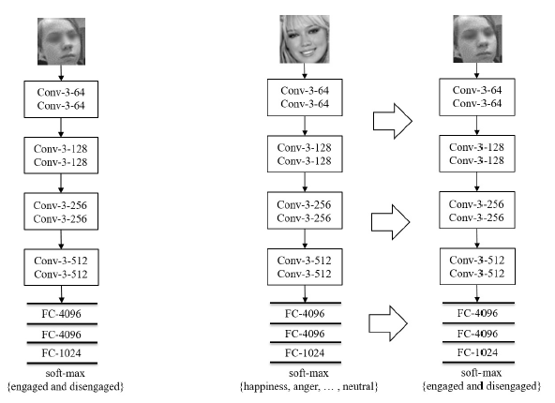
Engagement Recognition Model Architecture
Two models are created which is like VGG-B architecture, but with two fewer Conv
Randomly, initialized model is called as VGGNET Model (one the left)
Engagement Model, shown on the right, has same architecture except softmax layer initialized using the weights from the rich facial representation model
The model contains 8 convolutional (Conv.) layers
two max pooling (Max.) layers with stride 2,
Three fully connected (FC) layers
Rectified linear unit (ReLU) activation function
A softmax layer, followed by a cross-entropy loss, to classify
Notes:
To overcome model over-fitting, we apply a dropout layer after every Conv. and hidden FC layer. Local response normalization is used after the first Conv. layer. As the optimizer algorithm, stochastic gradient descent with minibatching and a momentum of 0.9 is used
In the training phase, for data augmentation, input images are randomly flipped along their width and cropped to 48-by-48 pixels (after applying zero-padding because the samples were already in this size). Furthermore, they are randomly rotated by a specific max angle.We set learning rate for the VGGNET MODEL to 0:001 and for other models to 0:002. The batch size is set to 32 for the ENGAGEMENT MODEL and 28 for other models. The best model on the validation set is used to estimate the performance on the test partition of the ER dataset for all models in this work.

Slide 17
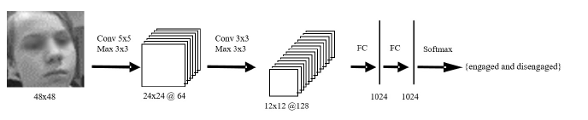
CNN Baseline Model
The model contains two convolutional (Conv.) layers and is termed as CNN Model
Same specifications for max pooling, FC and softmax
To overcome model over-fitting, we apply a dropout layer after every Conv. and hidden FC layer. Local response normalization is used after the first Conv. layer. As the optimizer algorithm, stochastic gradient descent with minibatching and a momentum of 0.9 is used
Notes:
normalized so that it has a zero mean and a norm equal to 100:0. Furthermore, for each pixel location, the pixel values are normalized to mean zero and standard deviation one using all ER training data

Slide 18
Results
Results from Paper Model Evaluation
Results on Testing on Yale dataset
Results from Training on Yale dataset

Slide 19
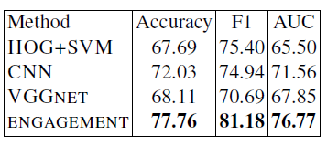
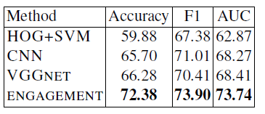
Findings from evaluations
Validation Result
On the validation and test sets, the ENGAGEMENT model substantially outperforms all baseline models using all evaluation metrics, showing the effectiveness of using a trained model on basic facial expression data to initialize an engagement recognition model
All deep models including CNN, VGGNET, and ENGAGEMENT MODELS perform better than the HOG+SVM method showing the benefit of applying deep learning to recognize engagement
Test Result
Notes:
On the test set, the ENGAGEMENT MODEL achieves 72:38% classification accuracy, which outperforms VGGNET by 5%, and the CNN MODEL by more than 6%; it is also 12:5% better than the HOG+SVM method. The ENGAGEMENT MODEL achieved 73:90% F1 measure which is around 3% improvement compared to the deep baseline models and 6% better performance than the HOG+SVM MODEL. Using the AUC metric, as the most popular metric in engagement recognition tasks, the ENGAGEMENT MODEL achieves 73:74% which improves the CNN and VGGNET MODELS by more than 5% and is around 10% better than the HOG+SVM method. There are similar improvements on the validation set

Slide 20
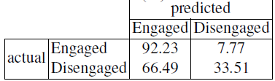
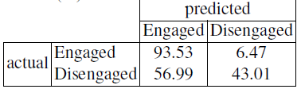
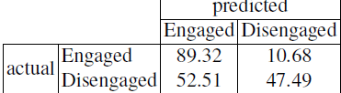
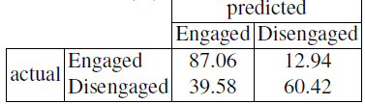
Findings from evaluations
HOG+SVM Model
The VGGNET MODEL, which has a more complex architecture compared to the CNN MODEL, can also detect disengaged samples with a higher probability
ENGAGEMENT MODEL on basic facial expression data including considerable variations of samples, this model is the most effective approach to recognize disengaged samples achieving 60.42% precision which is around 27% improvement in comparison with the HOG+SVM MODEL
CNN Model
VGGNET Model
ER Model

Slide 21
Setup for Novelty Experiment & Results

Slide 22
Setup
Train ER Model
Yale Facial Dataset
Input data
The Class probabilities are used to initialize the softmax layer of ER model
Performance evaluation by comparison with other baseline models
Preprocess data to get proper data for feeding into the model
Data annotated with engage/disengaged labels
Train CNN Model
VGGNet Model
Test directly on paper’s ER Model
Notes:
new dataset annotated by Psychology students, who can potentially better recognize the psychological phenomena of engagement, because of the complexity of analyzing student engagement. To assist them with recognition, brief training was provided prior to commencing the task and delivered in a consistent manner via online examples and descriptions

Slide 23
Yale Facial Recognition Dataset
The dataset
consisting of 165 images which was annotated separately. It has 97 engaged and rest disengaged
132 training dp
22 validation dp
11 test dp
The dataset was chosen because of various complications and scenarios which would challenging for the models to predict
Glasses and non glasses mix of pictures
Different lighting conditions (Right, Left, Central lightings)
Different Emotions (sad, happy, normal, sleepy, yawning etc)
All these conditions and situations were not specifically mentioned in the paper, which is why it would be interesting to see,
how the models would perform
Notes:
normalized so that it has a zero mean and a norm equal to 100:0. Furthermore, for each pixel location, the pixel values are normalized to mean zero and standard deviation one using all ER training data

Slide 24
Yale Facial Recognition Dataset
Vote 3 : Engaged
Vote 1 : Engaged
Yale data set Image
Vote 4: Engaged
Vote 2 : Engaged
Vote 5: Disengaged
Labeled as Engaged
The dataset was labeled with engaged and disengaged using group a friends who would provide a vote in each and image
on whether the image was engaged or disengaged. The majority vote was then selected to be the designated label for that image
This was done in order to remove any single human biasness and reduce subjectivity and ambiguity
Notes:
normalized so that it has a zero mean and a norm equal to 100:0. Furthermore, for each pixel location, the pixel values are normalized to mean zero and standard deviation one using all ER training data

Slide 25
Direct Testing the models
Yale data directly put into testing and predicting the engagement on paper’s original model using pre trained models
On the validation and test sets, the ENGAGEMENT model continues to be biased towards predicting disengaged samples
The VGG model continues to biased towards predicting engaged samples more, although CNN model shows less bias but overall accuracy is equivalent to ER model
Notes:
On the test set, the ENGAGEMENT MODEL achieves 72:38% classification accuracy, which outperforms VGGNET by 5%, and the CNN MODEL by more than 6%; it is also 12:5% better than the HOG+SVM method. The ENGAGEMENT MODEL achieved 73:90% F1 measure which is around 3% improvement compared to the deep baseline models and 6% better performance than the HOG+SVM MODEL. Using the AUC metric, as the most popular metric in engagement recognition tasks, the ENGAGEMENT MODEL achieves 73:74% which improves the CNN and VGGNET MODELS by more than 5% and is around 10% better than the HOG+SVM method. There are similar improvements on the validation set

Slide 26
Training and then Testing the models
Yale data was divided into training, validation and testing datasets
On the validation and test sets, the ENGAGEMENT model gives the lowest overall accuracy after training and then testing on Yale dataset. It is completely biased towards identifying disengaged
While CNN and VGG models are more biased towards predicting Engaged samples and because engaged samples were higher in percentage in the Yale dataset which is why overall accuracy is coming higher
Notes:
On the test set, the ENGAGEMENT MODEL achieves 72:38% classification accuracy, which outperforms VGGNET by 5%, and the CNN MODEL by more than 6%; it is also 12:5% better than the HOG+SVM method. The ENGAGEMENT MODEL achieved 73:90% F1 measure which is around 3% improvement compared to the deep baseline models and 6% better performance than the HOG+SVM MODEL. Using the AUC metric, as the most popular metric in engagement recognition tasks, the ENGAGEMENT MODEL achieves 73:74% which improves the CNN and VGGNET MODELS by more than 5% and is around 10% better than the HOG+SVM method. There are similar improvements on the validation set

Slide 27
Conclusion

Slide 28
Conclusion
Although the paper provides considerable proof that ER model should give best prediction compared to baseline model in predicting student engagement, but this doesn’t seem to be case
ER model more or less equivalent to baseline models when the dataset changes and is more biased towards predicting disengaged samples while VGG at predicting engaged samples.
This above conclusion would require more extensive testing against more databases. Due to low size of Yale dataset compared the dataset used by the Authors, might play a role in the low accuracy predictions
The low accuracy could also be because of the fact that the Yale dataset did bring in new challenges which might have not been covered in the paper. The paper never mentions whether lighting situation, face covering with glasses etc were part of the dataset or not
Future Implementations that can be performed:
Test the model on a different and more complicated dataset involving lighting variation, subjects with glasses and without
Play around with model network architecture to see its impact on time complexity and accuracy, also look at whether other VGG net or ResNet architecture can be implemented in this problem statement as another baseline model

Slide 29
Demo

Slide 30
Data and Codes Link
Datasets
FER dataset- https://www.kaggle.com/competitions/challenges-in-representation-learning-facial-expression-recognition-challenge/data
Yale dataset - https://www.kaggle.com/datasets/olgabelitskaya/yale-face-database
Code
Testing Code: https://drive.google.com/drive/folders/1EZpDY_WKTsRExnhU-AS_U8G6dNje2nUp?usp=sharing
Training Code: https://drive.google.com/drive/folders/1Zwhg5kC_pDImCt3fmIHiU4M7WPVTnKEx?usp=share_link
Instructions
Read the readme file in each of the links above to run the code
Yale dataset would require you to convert it to jpg or jpeg format for the preprocessing code to work or you can directly use the images provided in the code link folder

Slide 31
The End

